Slide 1
Python – Exceptions & Try/Except Blocks – A Start
From the Python Made Easy Series- based on Python 3.7

Slide 2
What are Python Exceptions?
Sometimes errors should cause a program to terminate, but other times you want to recover from them and continue to process your code, that’s what this class is all about.
Exceptions are events that can modify the flow of a computer program
They are triggered automatically when errors occur
They can also be triggered manually by our code
There are four different statements that process exception:
Try/except
Try/finally
Raise
Assert
with/as
Exceptions can be raised in any part of a program
All errors are exceptions, but not all exceptions are errors (i.e. Ctrl-C raises a SystemExit- this is a signal and NOT an error)

Slide 3
Why would we use Exceptions?
They enable us to break out of a section of our code
And then respond to the exception in a way that is useful to our program
They allow us to jump to certain sections of our code based on conditions. They can be seen as “go-to” commands

Slide 4
What purpose do exceptions serve?
Error Handling - to catch and respond to errors that arise in code
Even Notification – This is to signal a valid condition
Termination Actions – This ensures that specific operations will be performed if an exception occurs or not
Control Flows – Exceptions can be used to control the flow of our programs (i.e. to break out of multiple loops)
Special-case Handling – This is for a condition that rarely occurs

Slide 5
The try/except block
1
When error is raise, the program stops executing with out try/except
1
2
Using try/except, program catches error, prints out and keeps executing
2

Slide 6
Different Error Types in the try/except block
3
5
7
1
1
Attribute Error
2
Index Error
3
Type Error
4
Name Error
5
Syntax Error
6
Key Error
2
7
Catch All Errors
4
6

Slide 7
Why use the else clause with the try/except block
The benefits of using the else branch is it is a very clear way to know if there was an error and it was trapped, or if there was not error. The only way the else branch is taken is if there was no error trapped.. It’s not good enough to have a print statement immediately outside of the try/except because that will always run, so its not an indicator of what actually happened.

Slide 8
Reasons for using the try/finally block
The finally branch ensures the appropriate cleanup code is run
1
This first try/finally sees no error, but the finally branch is executed no matter what, so “No error. File is closed”, gets printed out. Following this, the execution of the code continues with the print statement outside the try/finally block “Keep going all is well.”
1
2
In the second example, we have a type error in the try branch, however, you see that the code in the body of the finally branch runs here too. , the difference is it terminates the program after this and DOES NOT run what immediately follows the try/finally since there was an error. It simply closes the file and terminates the program.
2

Slide 9
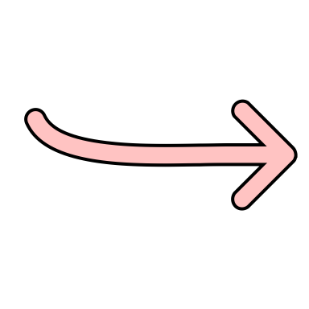
Unified try/except/finally block
1
For code snippet #1
We have a Type error in the try branch,
So that will be caught and the handler in the except branch will execute.
Then as it always does, the finally branch is run printing out its print statement….
Then instead of terminating in this case, the print statement after the try block is executed and we would proceed with our program from that point on.
1
2
For code snippet #2
We have a Type error in the try branch,
So that will be caught and the handler in the except branch will execute.
But In this code we have a Zero Division error in the except handler so….
Then as it always does the finally branch is run printing out its print statement….
But this time the code propagates to the default level handler and we see the ZeroDivisionError
Then the program terminates
2
Program Terminates

Slide 10

Trigger an Error Manually – The Raise Keyword
We can use the built-in raise exception statement to trigger and exception. When the exception is raised, program execution is interrupted as the interpreter searches back up the stack to find a context with an exception handler
Why might you want to raise an error?
The purpose of error checking- to indicate that the situation is exceptional to the normal flow
To give a user-friendly version of an error
To warn consumers if they are using code you built incorrectly
General Guidance Around Raising an Error
Be specific- Use the most specific exception constructor that fits your issue
The message string should clearly explain the problem
Here we through the raise a second time to propagate the error up to the default level handler
When we run this, it result in the error occurring

Slide 11
Using Class-Based Exceptions

Slide 12
The End
Keep breathing and code!

